Slide 1

G2M Case Study
Virtual Internship
-Jun-2022

Slide 2
Background –G2M(cab industry) case study
XYZ is a private equity firm in US. Due to remarkable growth in the Cab Industry in last few years and multiple key players in the market, it is planning for an investment in Cab industry.
Objective : Provide actionable insights to help XYZ firm in identifying the right company for making investment.
The analysis has been divided into four parts:
Data Understanding
Forecasting profit and number of rides for each cab type
Finding the most profitable Cab company
Recommendations for investment

Slide 3
Data Exploration
24 Features( including 9 derived features)
Timeframe of the data: 2016-01-31 to 2018-12-31
Total data points :355,032
Assumptions:
Outliers are present in Price_Charged feature but due to
unavailability of trip duration details ,we are not treating this as outlier.
Profit of rides are calculated keeping other factors constant and only
Price_Charged and Cost_of_Trip features used to calculate profit.
Users feature of city dataset is treated as number of cab users in the city.
we have assumed that this can be other cab users as well(including Yellow and
Pink cab)
Cab_Data.csv
Customer_ID.csv
Transaction_ID.csv
City.csv
USholiday.csv
Final cab data

Slide 4
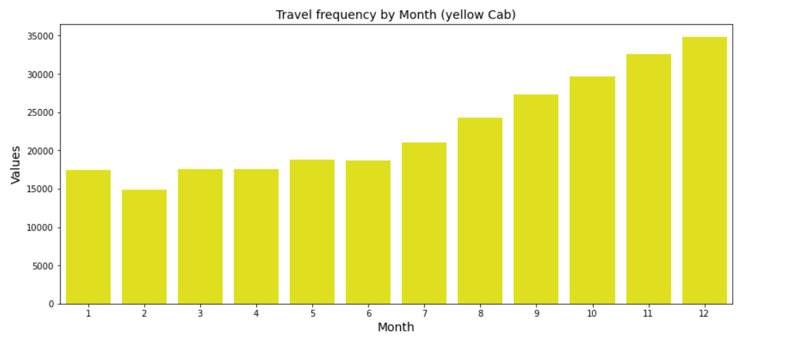
Profit Analysis
Company spread analysis

Slide 5
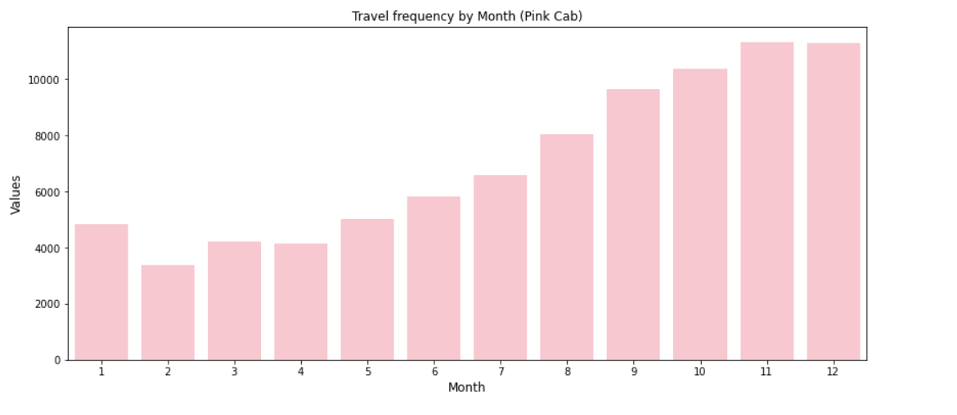
Company spread analysis

Slide 6
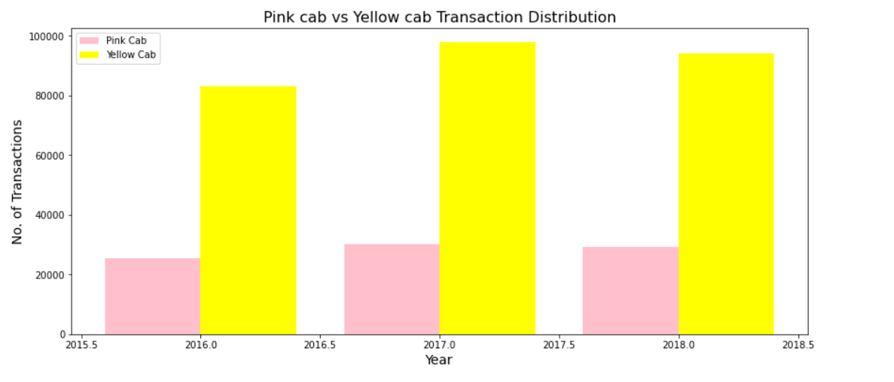
Company spread analysis

Slide 7
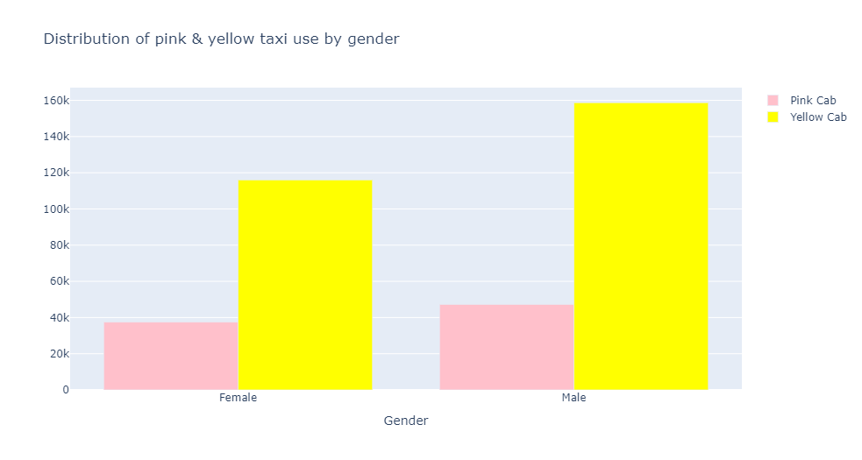
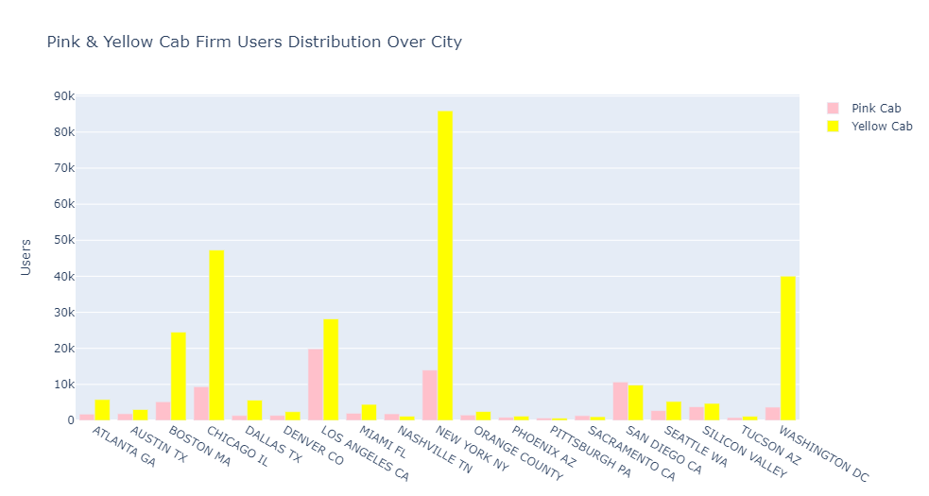
Users analysis

Slide 8
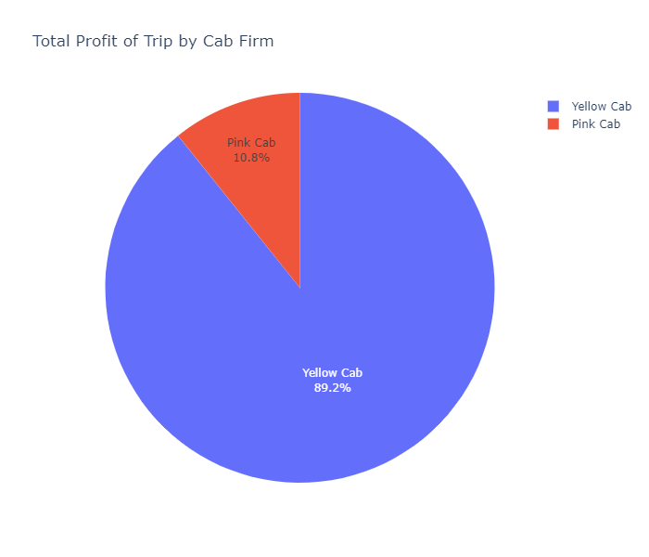
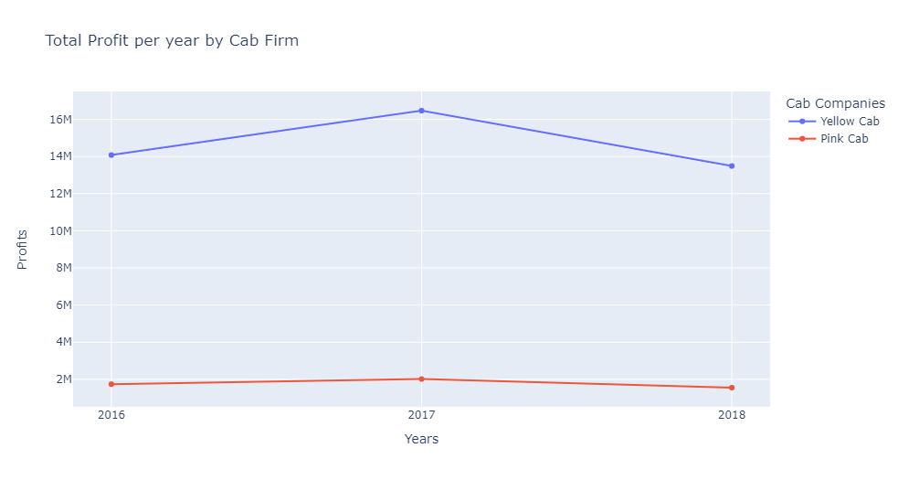
Profit Analysis

Slide 9
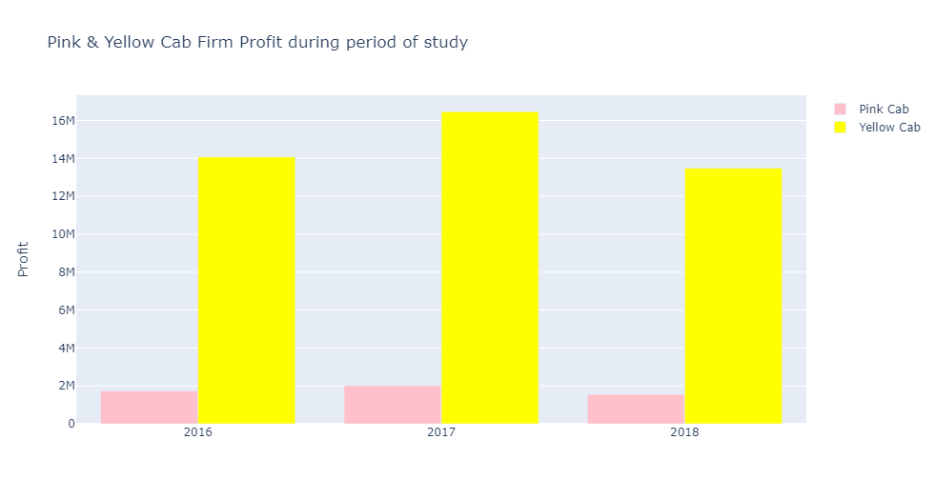
Profit Analysis

Slide 10
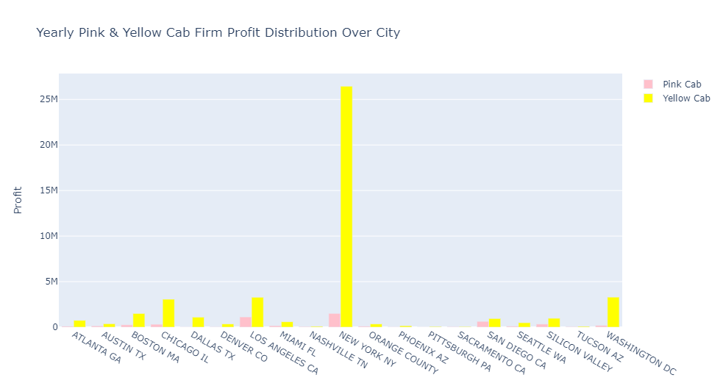
Profit Analysis

Slide 11
Recommendations
We have evaluated both the cab companies on following points and found Yellow cab better than Pink cab:
Customer : Yellow cab has higher customer than Pink cab. We have also observed that Yellow cab is doing good in covering other cab users as compared to Pink cab.
Age & Gender: Yellow cab has customer in all ages and both genders and it’s been observed that it’s even popular in 60+ age group.
spread : yellow cab has more spread over the cities compare with pink cab, that can be seen in the Transaction graphs.The yellow taxi company has a wider spread than the pink taxi during the years, according to the chart
Profit : Yellow cab’s profit per KM is almost three times the average profit per KM of the Pink cab as can seen in the graphs. However, According to "Pink & Yellow Cab Firm Profit during period of study" showing that Both companies reached peak profits in 2017, But the yellow taxi company is higher during the entire period.
On the basis of above point , we will recommend Yellow cab for investment.

Slide 12
Moath Musallam
Thank You

